Slide 1
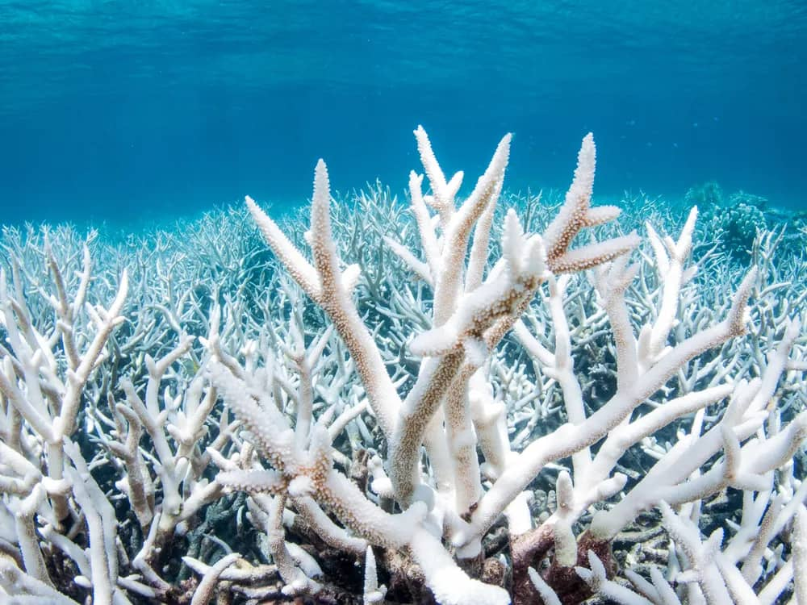
TEMPERATURE EFFECTS ON CORAL REEFS
BIOL 454 GROUP 1

Slide 2
OUTLINE
Introduction
What is a Coral?
Symbiosis in Corals
Stresses of Coral Reefs
Temperature Effects of Coral Reefs
Response to High Temperatures
Ecological Implications of Coral Bleaching
Conclusion
References

Slide 3
Introduction
Under water ecosystem of reef-building corals
Are formed when polyps are held together by CaCO3 exoskeleton.
Nick-named Rainforests of the Sea
Are very sensitive to temperature changes.

Slide 4
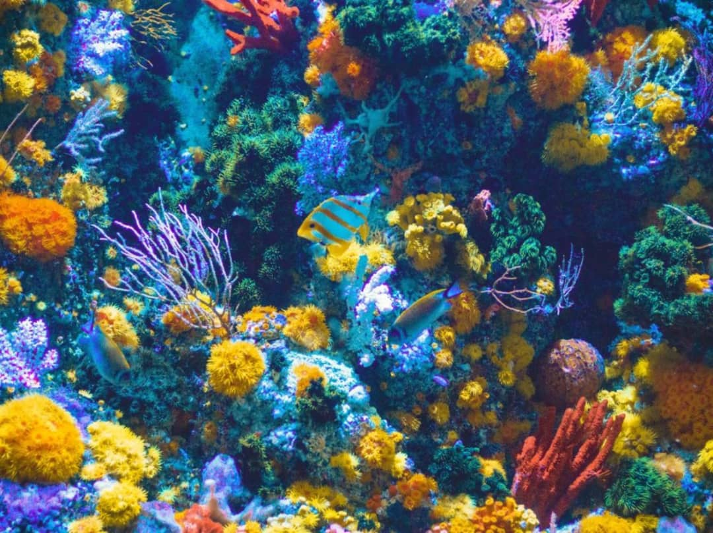
INTRODUCTION
Fig 1.0: A coral reef

Slide 5
What is a Coral
Phylum Cnidaria (includes Sea Anemones and Jellyfish
Class Anthozoa
Unlike sea anemones, corals secrete hard Calcium exoskeleton (support and protection)

Slide 6
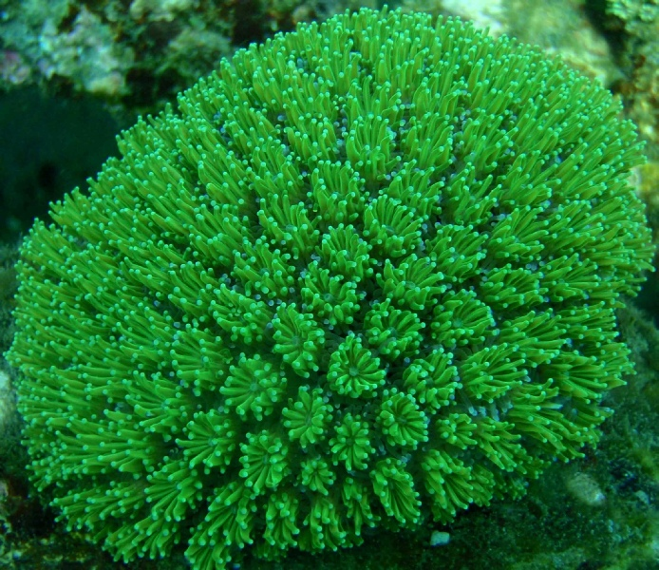
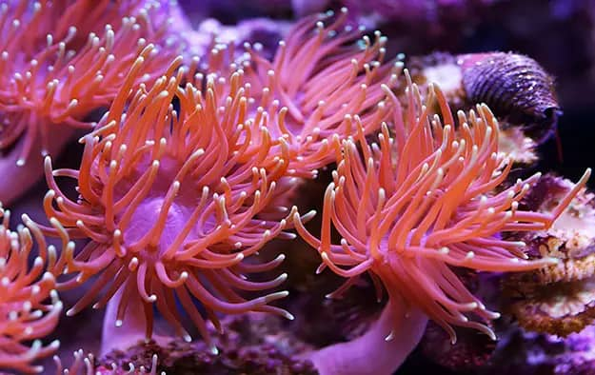
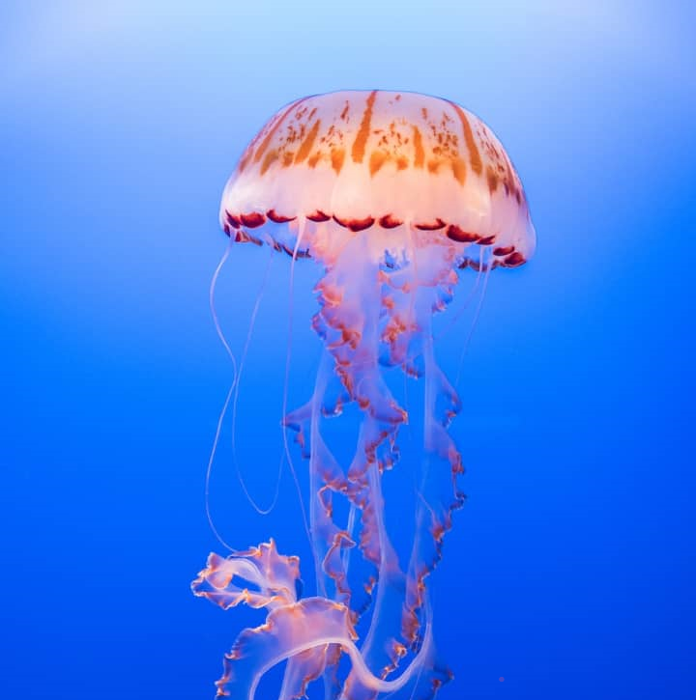
WHAT IS A CORAL? CONT’D
Fig 2.0: Corals
Fig 2.1: Sea anemones
Fig 2.2: A jellyfish

Slide 7
Symbiosis in Corals
Polyps live in an endosymbiotic relationship with Zooxanthellae (Single-celled dinoflagellates)
Most known zooxanthellae belong to the genus Symbiodinium
Zooxanthellae; Provide nutrients (photosynthesis)
Corals; Provide Carbon dioxide and Ammonia needed for photosynthesis, and shelter

Slide 8
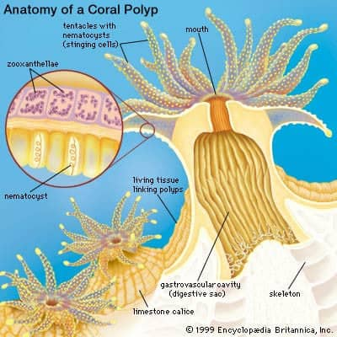
Symbiosis in corals
Figure 3.0: Diagram of the anatomy of a coral polyp showing zooxanthellae in tissues

Slide 9
Stressors of Coral Reefs
Temperature Changes (most important)
Increased Solar Irradiance
Increased Sedimentation
Bacterial Infections
Changes in Salinity

Slide 10
Temperature Effects on Coral Reefs
Optimum temperature between 23˚C and 29˚C
A temperature rise of 1˚C -2˚C leads to stress.
Too low temperatures also cause stress but are less prominent.

Slide 11
Response to too High Temperatures
Zooxanthellae Response: Produces reactive oxygen species such as peroxides and superoxide.
These are toxic to the corals as it causes oxidative stress.
Coral Response: Expels the zooxanthellae from its tissues through exocytosis.

Slide 12
Response to too High Temperatures Cont’d
This cascade of cause-effect relationships leads to Coral Bleaching (Lighter or completely white appearance)
Bleached corals starve and are susceptible to disease.
Prolonged effects may lead to death.

Slide 13
Response to too High Temperatures Cont’d
Figure 4.0 A bleached coral reef

Slide 14
Ecological Implication of Coral Bleaching
Healthy coral reefs are very productive
Occupy less than 0.1% of worlds ocean area
Yet provide home for at least 25% of all marine species.
Coral bleaching therefore results in loss of marine biodiversity.
Unfortunately, rising ocean temperatures is a current climate trend driven by human activities such as Emission of Green House Gases

Slide 15
CONCLUSION
3/4th of the world’s reef systems are severely bleached.
Knowing the cause and physiological mechanism behind the loss of one of the world’s most productive ecosystems is a crucial step towards halting and reversing the loss.

Slide 16
                THANK YOU!!!

Slide 17
REFERENCES
US Department of Commerce, National Oceanic and Atmospheric Administration 13 September, 2021, What is Coral Bleaching.
The Guardian, 29 May 2017. Coral Bleaching on Great Barrier Reef worse than expected, surveys show
The Independent, 3 June 2017. The United Nations just released a warning that the Great Barrier Reef is dying

Slide 18
GROUP 1
KUNYELEWOSI ALEXANDER
ADAM DUSHMAN KHADIJAH
BAIDOO SAMUEL
BONSU DANIELLA ABENA
KYEREMATENG EMMANUELLA TIWAA
GYAMFI KWAME FRIMPONG
KARIKARI ANN AGYAKOMAH TAWIAH

